Slide 1
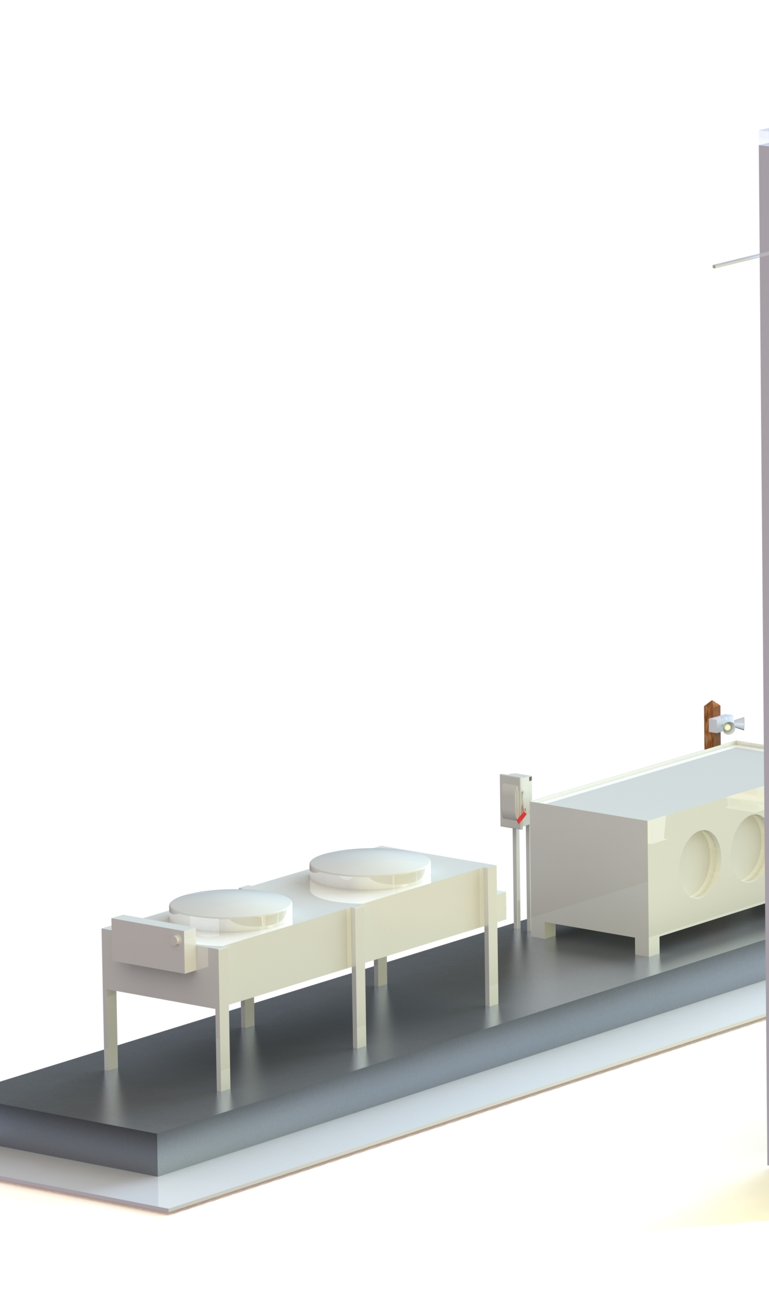
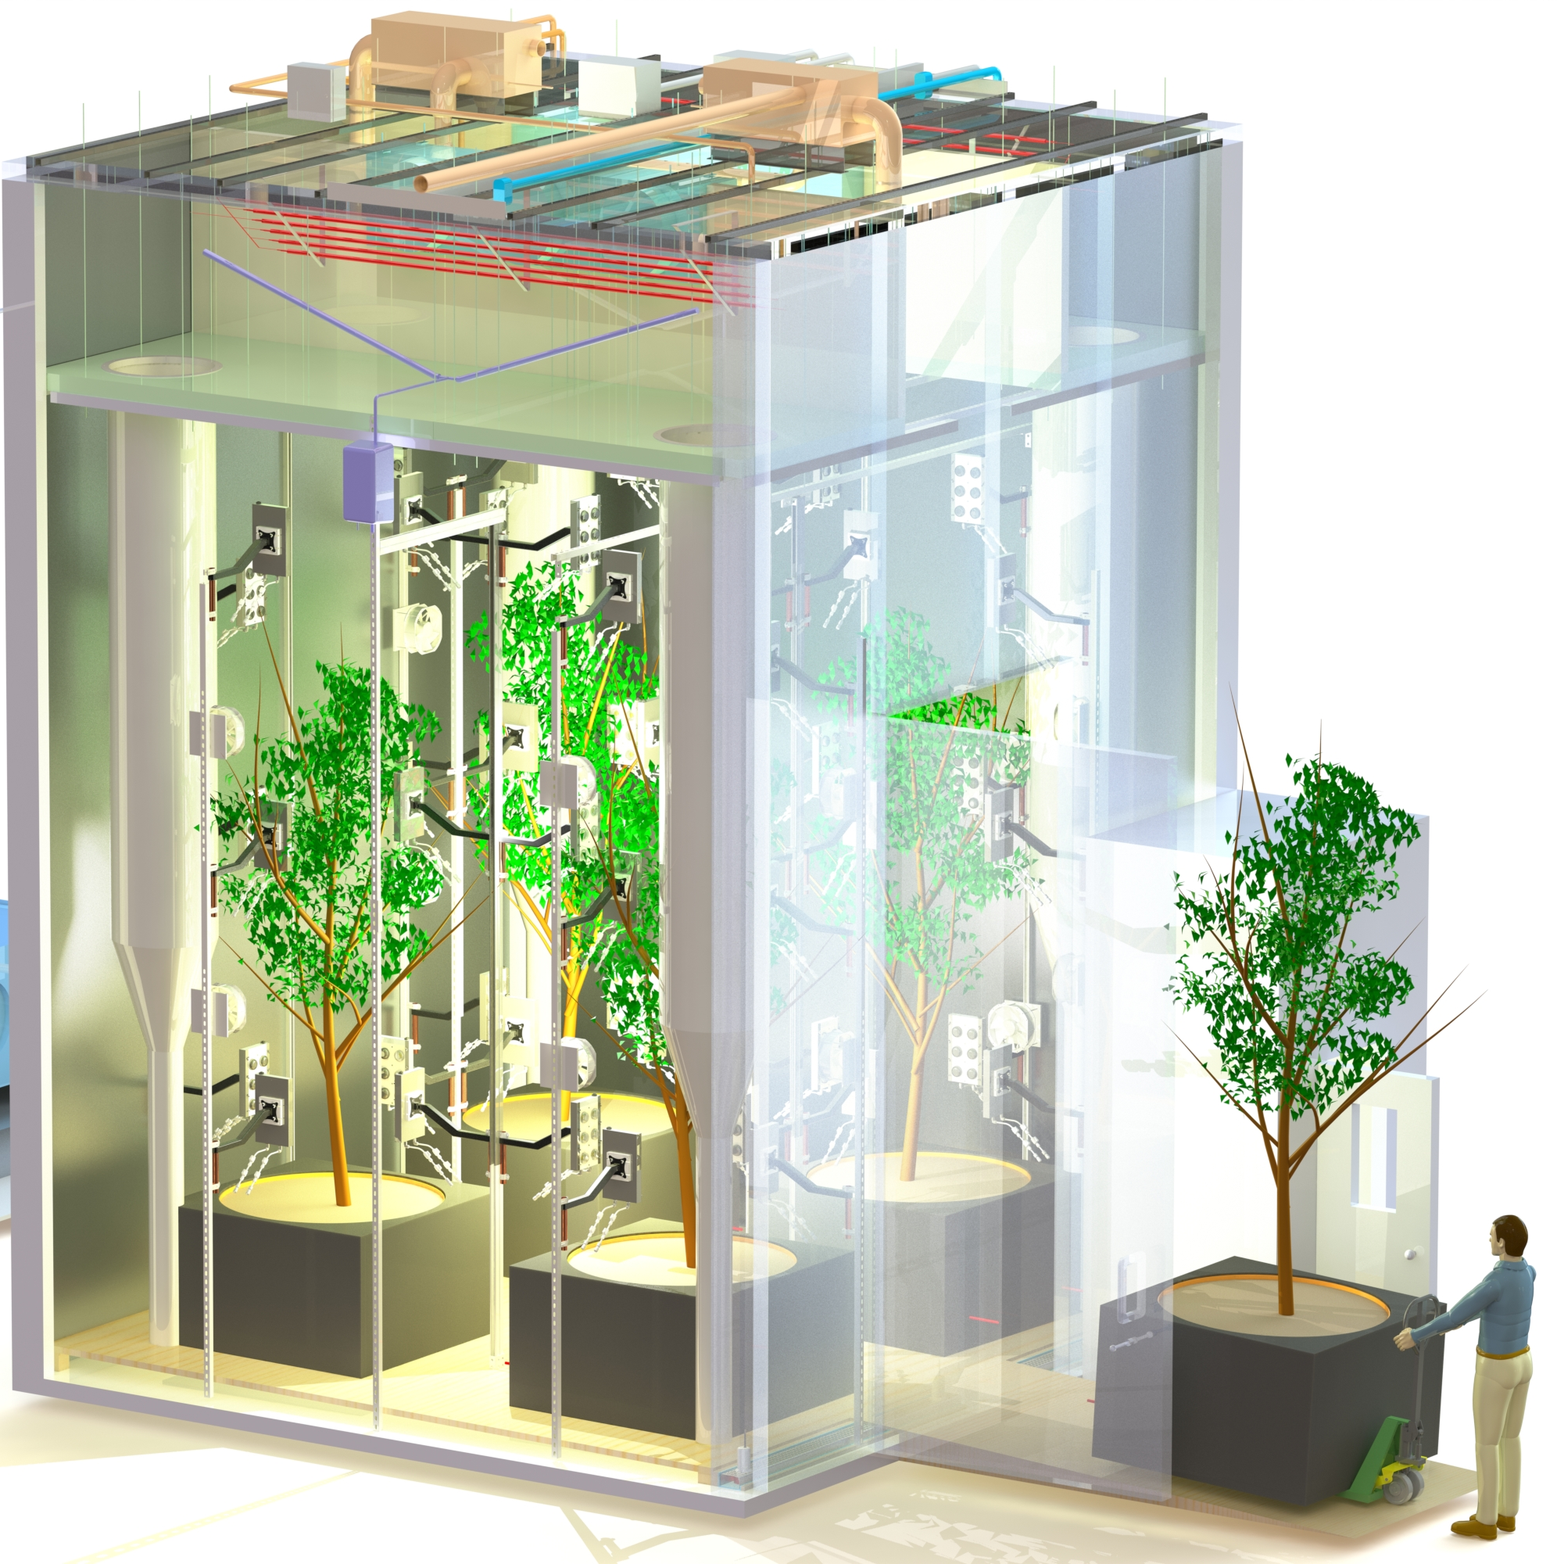

The Tree
Computer
https://www.media.mit.edu/projects/tree-computer/overview/

Slide 2
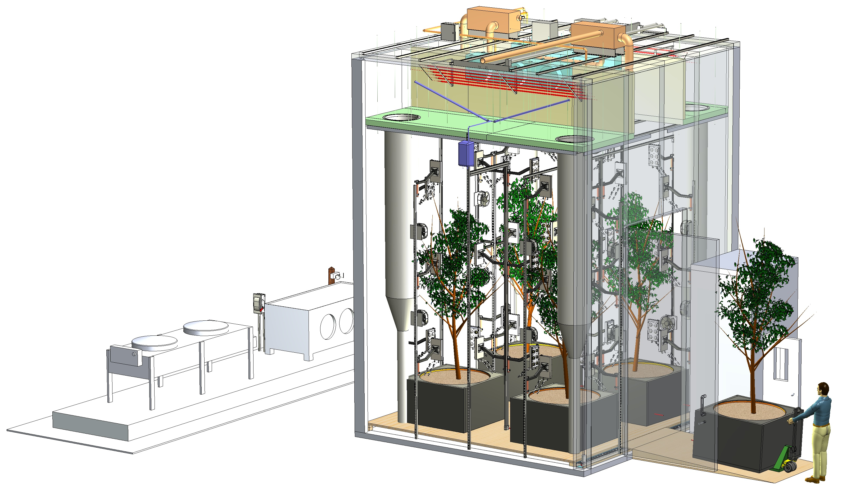
The Tree
Computer
https://www.media.mit.edu/projects/tree-computer/overview/

